Slide 1


Slide 2
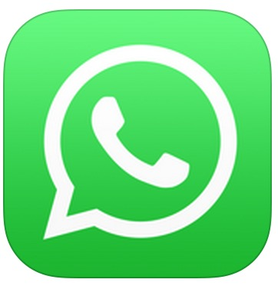
WhatsApp Messenger is a cross-platform mobile messaging app which allows you to exchange messanges.
WhatsApp Messenger uses the internet conection.
WhatsApp users can create groups, send each other unlimited images, video, and audio messages.

Slide 3
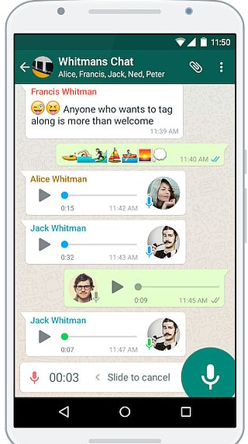
Functional testing
Functionality testing is performed to verify that a software application performs and functions correctly according to design specifications.
Makeing Calls
Video Call
Voice Call
Text messages
No limits
Audio, Video, Pictures, Voice record, Location, Contacts, Documents
Data transfer
Account settings
Notification
Chats and Data usage
Account settings

Slide 4
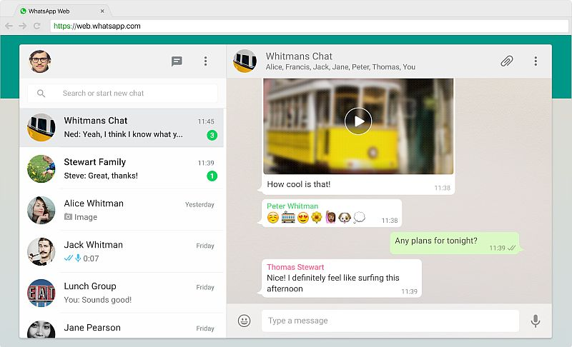
Integration Testing
Integration testing tests integration or interfaces between components, interactions to different parts of the system such as an operating system, file system and hardware or interfaces between systems.

Slide 5
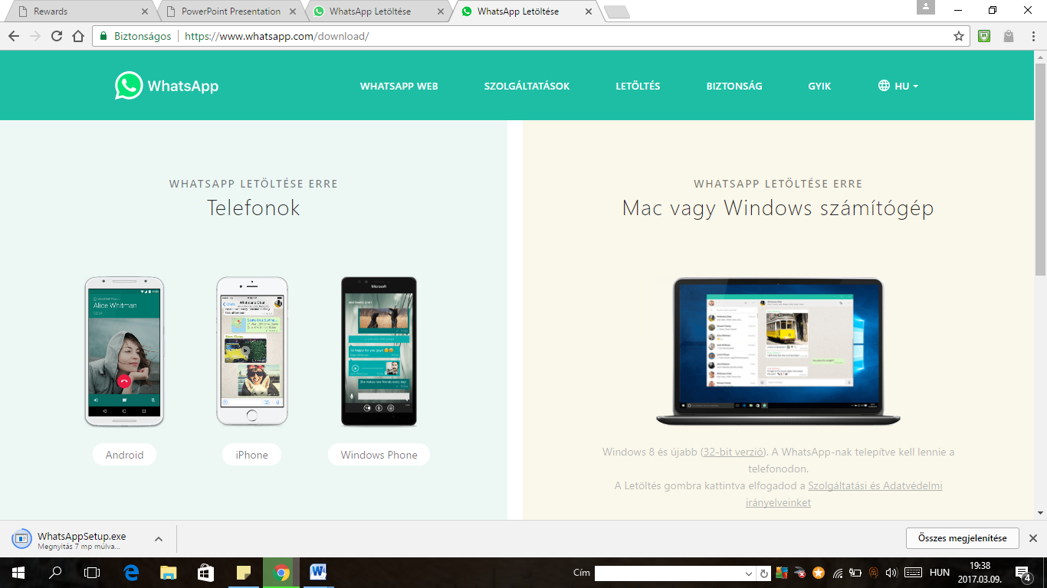
Non – Functional Testing
Possibility to download on phones and PCs
When unisnstalling – it deletes not just the icon but the whole app from my applications
It deletes all the conversations

Slide 6
Localization
Localization is a type of non-functional testing designing a software application so that it can be adapted to various languages and regions without any changes.
When installing it automatically gives me a country code as soon as I chose a country, and if I use a wrong country code I cannot validate my phone number
If I want to delete my profile, and I introduce a wrong country code, it won’t delete my profile

Slide 7
What is Compatibility Testing?
Compatibility Testing is a type of Software testing to check whether your software is capable of running on different hardware, operating systems, applications , network environments or Mobile devices.
Compatibility Testing is a type of the Non-functional testing.

Slide 8
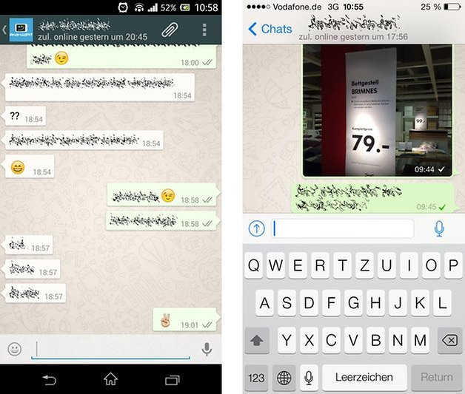
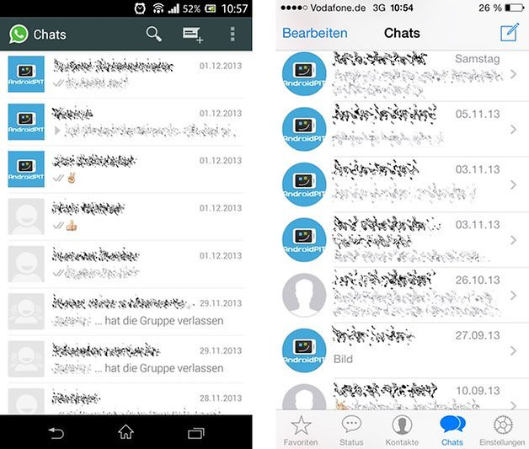
IOS 10.2.1 vs Android 5.0.1
Chat Overview-the iOS version looks much more sterile due to the choice of color elements, options such as contacts and settings can be accessed right away from the lower navigation bar. With Android, these are hidden behind the menu in the action bar.
Chat Window-the actual chat looks relatively identical and only the representation of icons and speech bubbles vary slightly. The button to attach files has been moved down to the text bar in iOS while that’s the area where the emoticon symbol is at for Android.

Slide 9
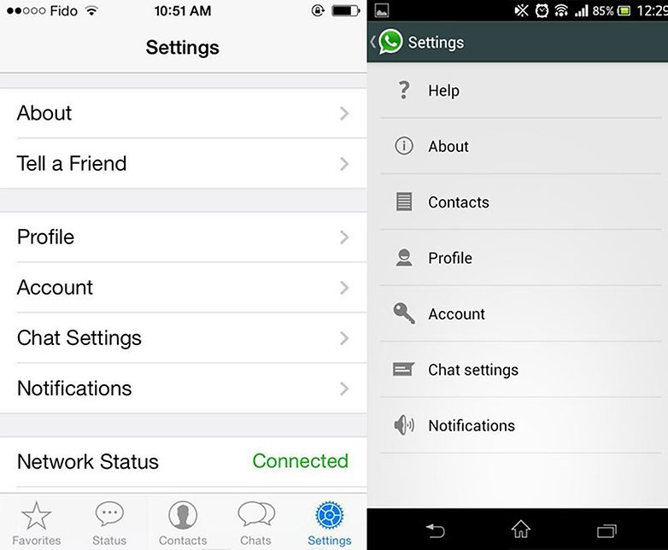
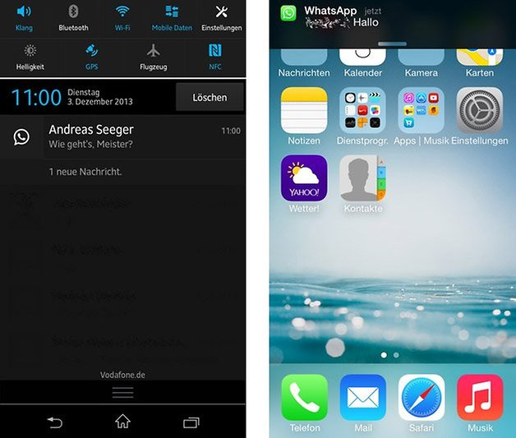
IOS 10.2.1 vs Android 5.0.1
Notifications- Whether in Android or iOS, there is no interactive button that allows you to reply directly to messages outside the app. Taping on the notification itself merely results in the app firing up and being able to reply from within WhatsApp. Android does have a small advantage here though, as it provides a little bit more information provided when in the notification bar.
Settings-The iOS version of WhatsApp has it’s setting grouped based on type and allows a little bit more intuitive navigation to the settings of your choice. However, the Android version has small icons to the left of the settings that allow a quick visual representation of what you’re looking for.

Slide 10
Interruption Testing
Interruption Testing of a mobile application deals with the behavior of an application in the cases where it is interrupted in the foreground, and resumes to a state prior to the interruption.
the application will be interrupted and the alarm or calendar reminder will pop-up and the notification/alarm will not disappear from the screen until is not canceled/dismissed/snoozed
Alarm or calendar reminders
the application will not be interrupted by an incoming SMS, but a small notification will appear on the upper bar menu of the phone and it's the user decision if will exit Wassup app. to view the SMS
Incoming SMS
the application will be interrupted by the notification of an incoming call and will return to the previous state after the phone conversation ends or the call is rejected
Incoming call

Slide 11
The application will not change and will keep all the messages/ images/attachments send before the shut off of the phone. If there is a written text for which the "send" button was not pressed before the shut off, the application will not be able to keep that writen and unsent text.
Device shot off
In case of network connection loss, the app. will keep the sent text or other attachments in a pending state until the connection is back again. When the application is again connected to the network, all the data sent while the connection was lost will be delivered to the recipient.
Network connection loss

Slide 12
USABILITY
Is the application efficient, effective, simple and appealing to use?
Usability testing is all about determining if a web/mobile application is what the user would want to use and come back to it or not.
Usability testing is a way to see how easy to use something is by testing it with real users.

Slide 13
Test case:
Verify how easy you can install application
Verify how easy the user can send message to any individual selected from his contact list or how easy can send and receive images, audio, video, emoticons in chat to individuals.
Verify that user can delete text, images, audio, video messages
Verify that user make WhatsApp calls to the person in his contact list and that user can receive WhatsApp calls from person in his contact list.
Verify that user can check the message delivered and read time for a message in the 'Message Info' section.
Verify that user can set a chat wallpaper or profile picture.
Verify that user can update notification settings like - notification sound, on/off, show preview for both group and individual chats.
Verify that user can disable/delete his WhatsApp account.
Verify that user update his phone number that is used by WhatsApp application.
Verify that user set privacy settings like turning on/off last seen, online status, read receipts etc.
Verify that user can block a user to prevent any message from getting received from the blocked contact.
Verify voice calling quality

